Slide 1
Data Stormers
Andrew, Jeff, Deelan, David, manahil
Notes:
Jeff
Introduce our group name and group members

Slide 2
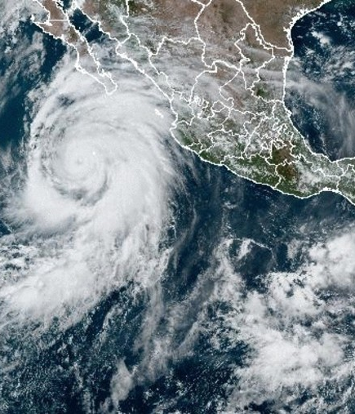
Agenda
Introduction
Research Questions
Data Sources
Geographic Focus
Data Analysis & Findings
Concluding Thoughts
Notes:
Jeff
Go over the agenda, what we will be discussing

Slide 3
Introduction
Tornado disaster analysis
Notes:
Jeff

Slide 4


Research questions
What trends are evident in the number of disaster declarations over time?
How are housing assistance funds distributed across different types of aid?
Which states experience the highest number of tornadoes?
Which states report the highest total housing damage?
How does the heat map illustrate tornado activity?
Does population size influence the frequency or severity of tornadoes?
How does the frequency of tornado-related disasters vary by month
How do valid registrations relate to approved housing assistance?
Notes:
Jeff
Go over our research questions

Slide 5
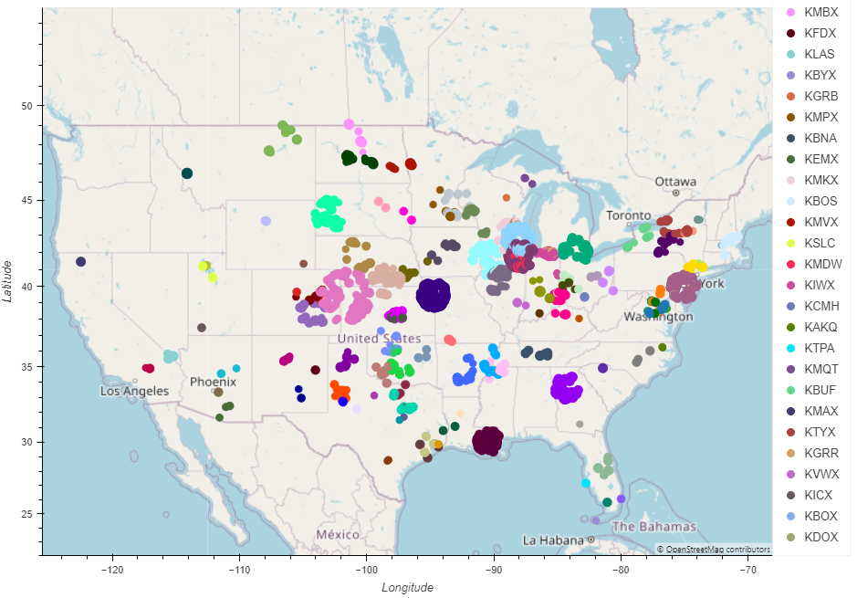
Tornado Info.
Measurement
Shear
MXDV
Azimuth
Notes:
David
Explain how tornadoes are measured
Map of all the radars that track them
Explain the data sources further

Slide 6
Geographic Focus
ENHANCING YOUR PRESENTATION
Notes:
Andrew
Talk about our focus on the United States and Tornadoes specifically instead of hurricane, tropical storms, etc. (Example: "Using a dataset worldwide would be too large so we narrowed our scope.")

Slide 7
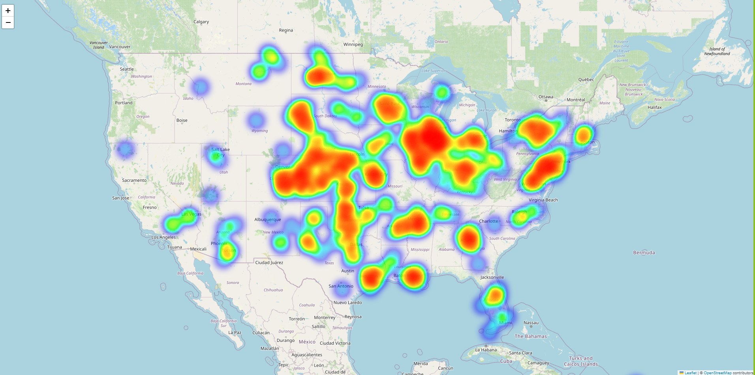
Heatmap Of the U.S. Region
The heat map visualizes tornado activity based on latitude and longitude coordinates. It displays regions with higher concentrations of tornado events using a color gradient.
This visualization helps in identifying geographic patterns of tornado activity, allowing for targeted preparedness and response efforts.
Notes:
Andrew
Have the html link during the presentation

Slide 8
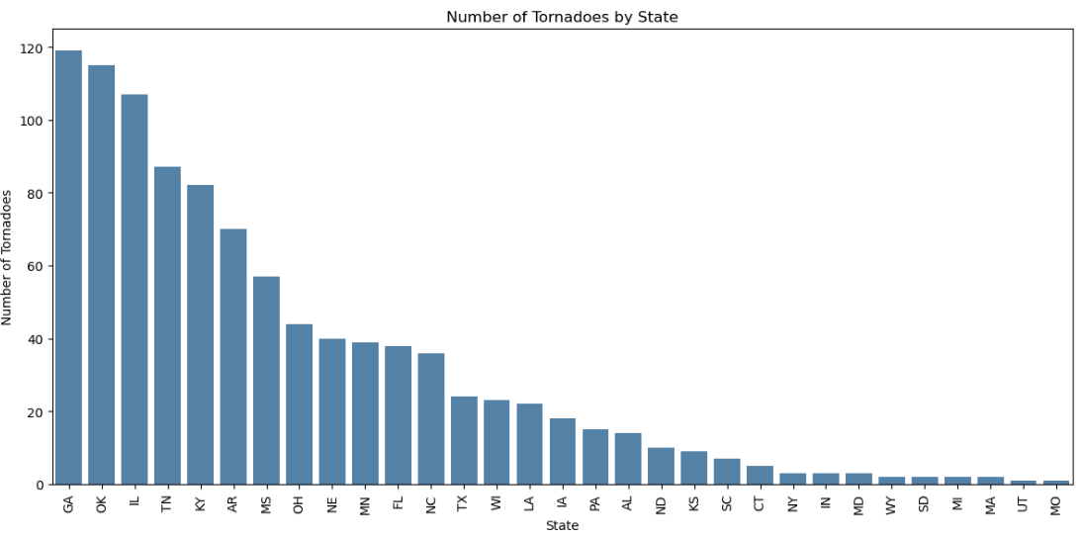
Tornado Frequency
This bar chart adds granularity to the heat map by quantifying tornado events in each state.
Comparing this with the heat map helps in understanding the specific tornado activity in high-frequency areas and can be used to correlate with damage and response data.
Notes:
andrew

Slide 9
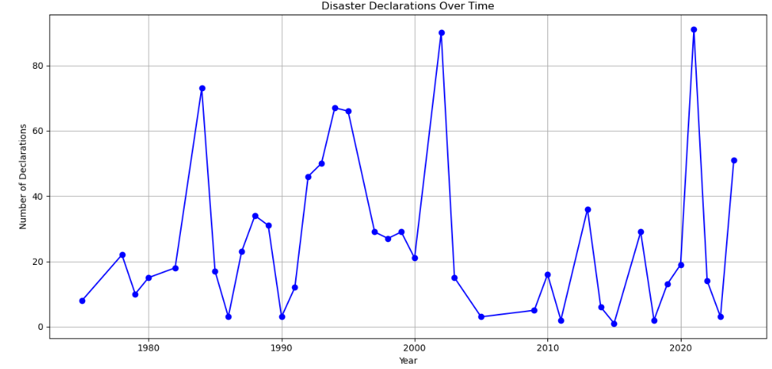
Trend of Disaster Declarations Over Time
The line plot provides context on disaster trends and helps link historical data with current tornado activity.
It offers insight into whether increased tornado activity corresponds with more disaster declarations, reflecting on data collection and awareness over time.
Notes:
andrew

Slide 10
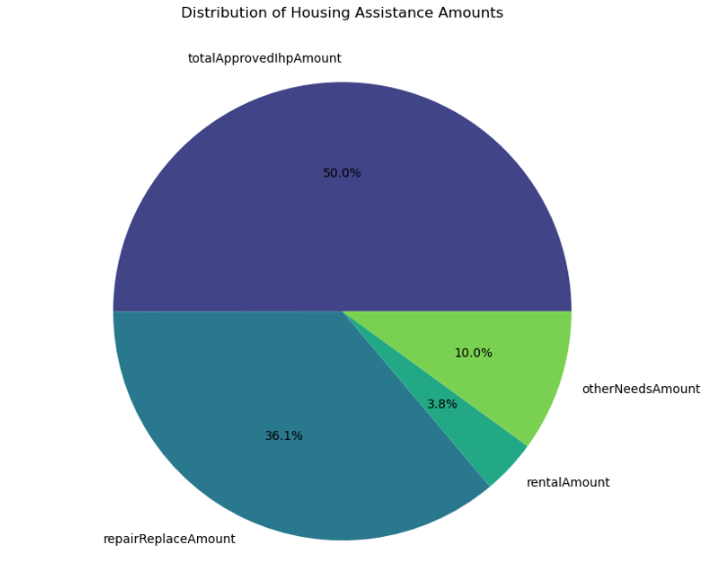
PIE Chart
This chart reveals how funds are prioritized for housing assistance, highlighting the focus on comprehensive support and repairs.
Understanding this helps in evaluating the effectiveness and allocation of resources in disaster recovery.
Notes:
andrew

Slide 11
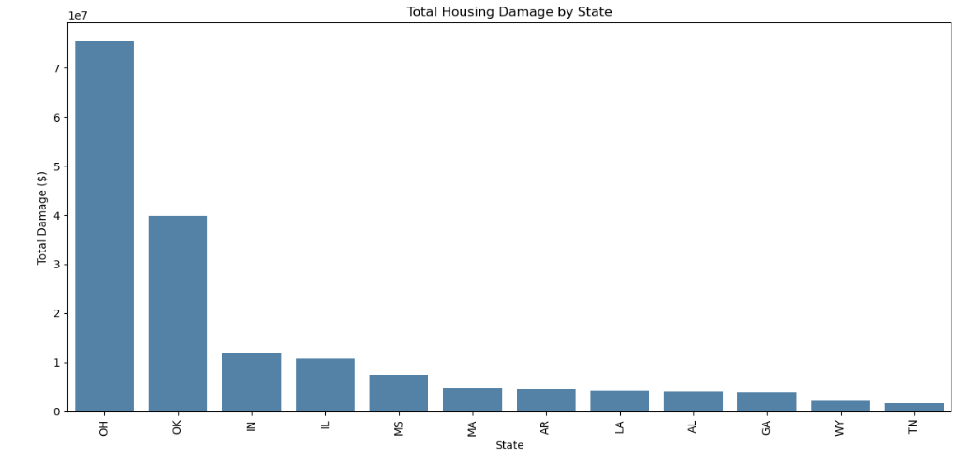
Total Housing Damage by State
This bar chart ties together the tornado activity with financial impact, showing which states experience the highest damage.
It is crucial for understanding the correlation between tornado frequency and housing damage and assessing the effectiveness of financial assistance.
Notes:
andrew

Slide 12
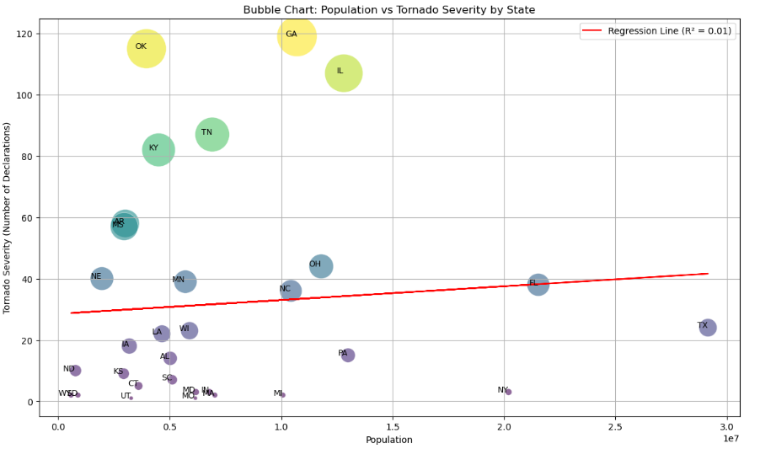
Bubble Chart
o Weak Correlation: Population size has a minimal impact on tornado severity.
o Notable States: OK, GA, and IL have high tornado severity despite varying
population sizes.
Notes:
manahil

Slide 13
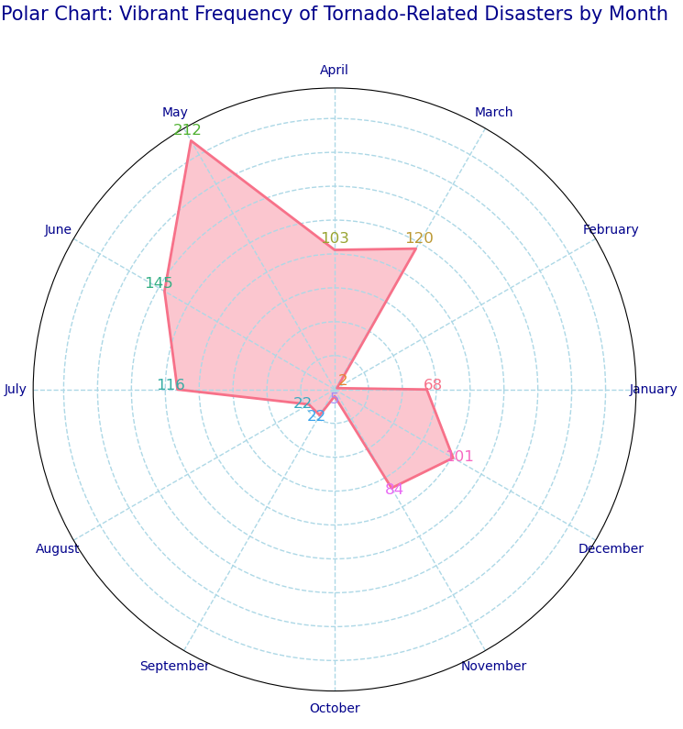
Polar Chart
Tornadoes peak in late spring, particularly in May, highlighting the need for heightened preparedness during this period.
Notes:
manahil

Slide 14
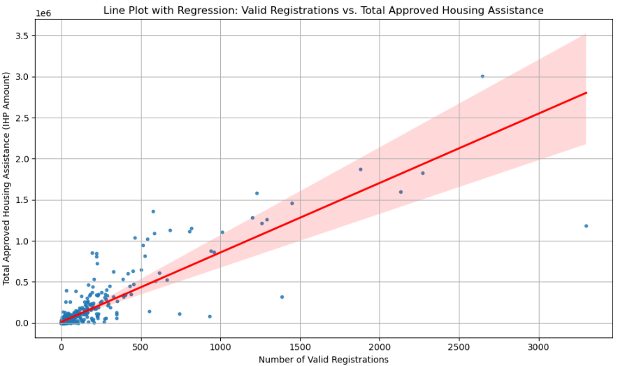
Line Plot with Regression
o Positive Correlation: Higher valid registrations are associated with more approved housing assistance.
o Outliers: Some data points deviate from the trend, indicating anomalies or special
cases.
Notes:
Deelan

Slide 15

Comparative Analysis
Synopsis
Factors
Optimization
Notes:
David
Synopsis
(Ex. "These charts give us a brief overview of tornado activities within the US")
Factors
Frequency
Financial Impact
Correlation Over Time
Optimization
Discuss what charts are better at what
Leads to a better understanding

Slide 16

Conclusion
Recap
Key Points
Research Questions
Implementation
Obstacles
Notes:
David
Summarize key findings
Answer research questions
Looking ahead with this data and how it can help (implementation)
What problems we encountered (Gathering data/Cleaning data)

Slide 17



Data sources
API’s
NOAA’s Severe Weather Data Inventory (SWDI) API
FEMA’s OpenFEMA API
United States Census Bureau API
Notes:
David
Introduce the API’s
How we utilized them

